Slide 1

#RollingScopes

Slide 2


Dzmitry Varabei aka “Dean”
8+ years of Software Development in EPAM
7 years in education and knowledge sharing as CDP/RD trainer
3 years in community building
Dzmitry Varabei
Chief Software Engineer

Slide 3
3 years ago…
1
2

Slide 4
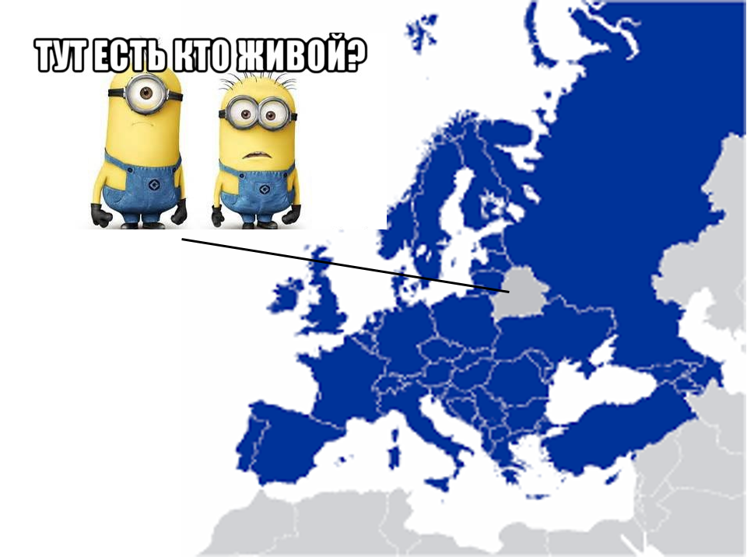

Slide 5
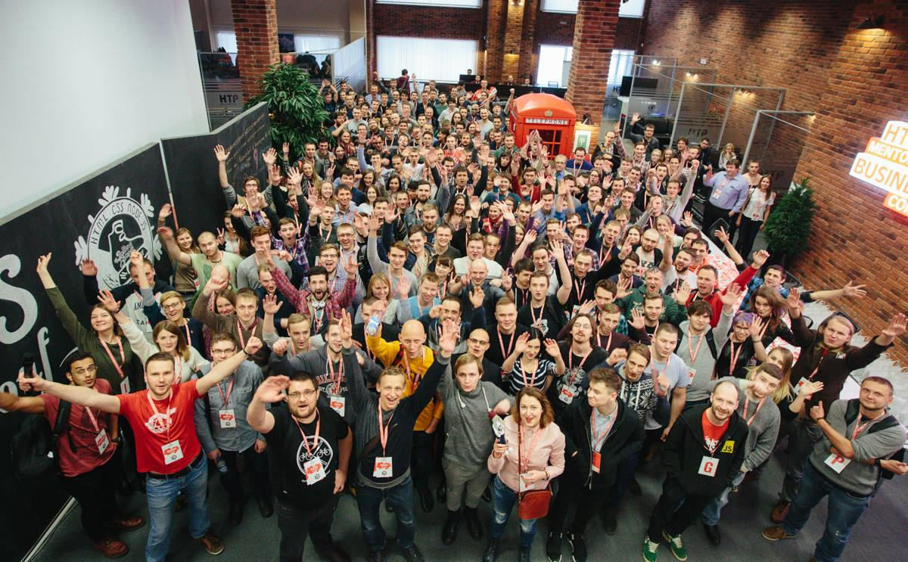
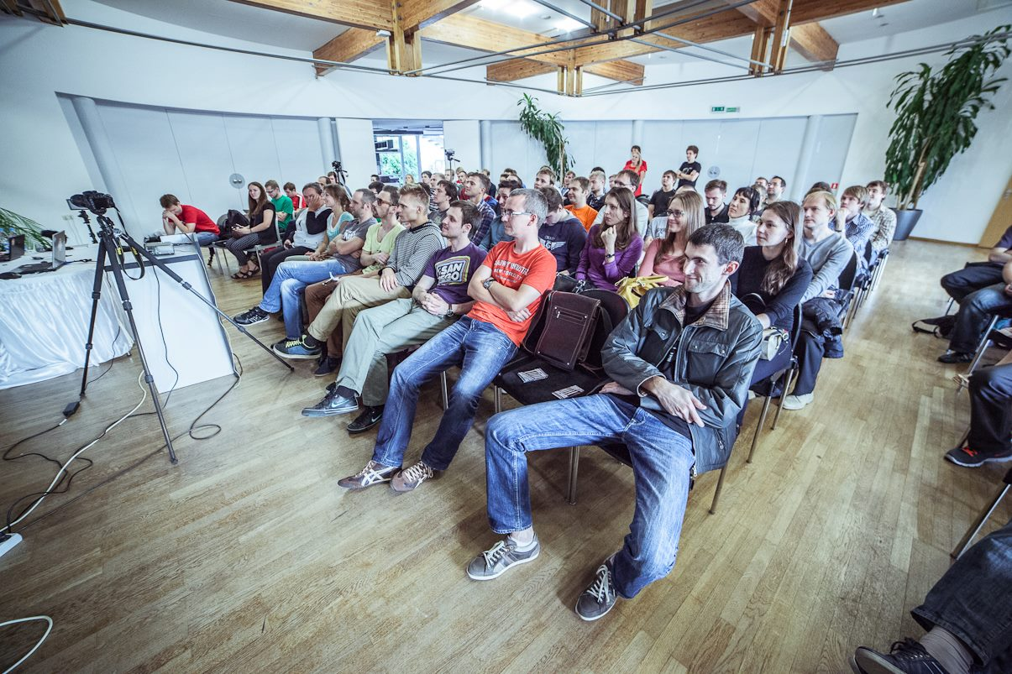
RSConf 2 Workshops 10+ Events 35+ Speakers 85+ Talks 150+

Slide 6
The Rolling Scopes meetups
Minsk
Brest
Gomel
Krakow
Gdansk
What's
next?

Slide 7
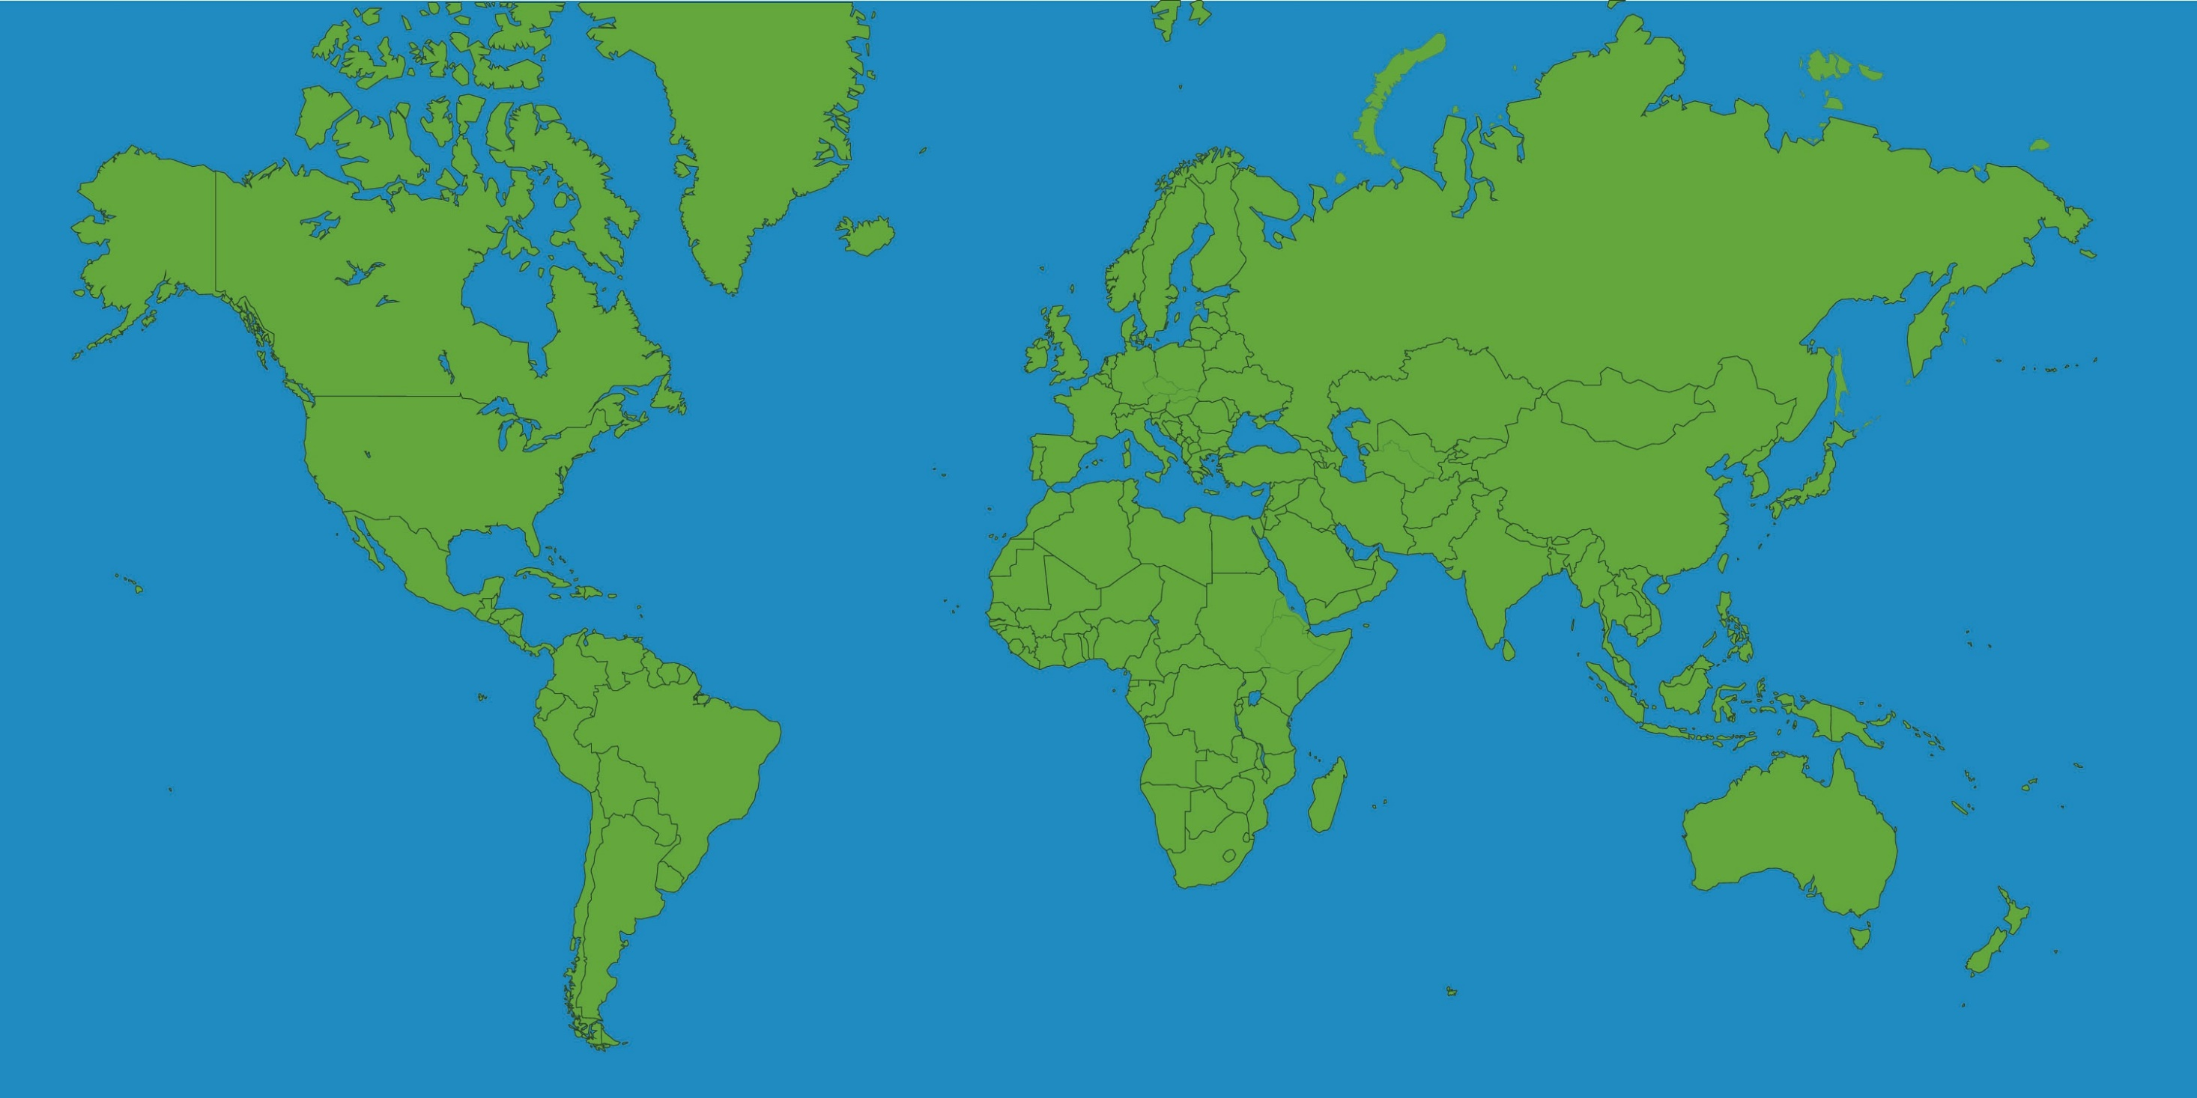


RS everywhere!

Slide 8
The most interesting facts…

Slide 9

Speakers wanted!
All the time!

Slide 10
Topics?
FRP
React
Tools
Best Practices
Browser internals
HTML5 Api
UX
CSS3
Racing drones
IoT
Blockchain
Virtual Reality
Psychology
Angular 2

Slide 11
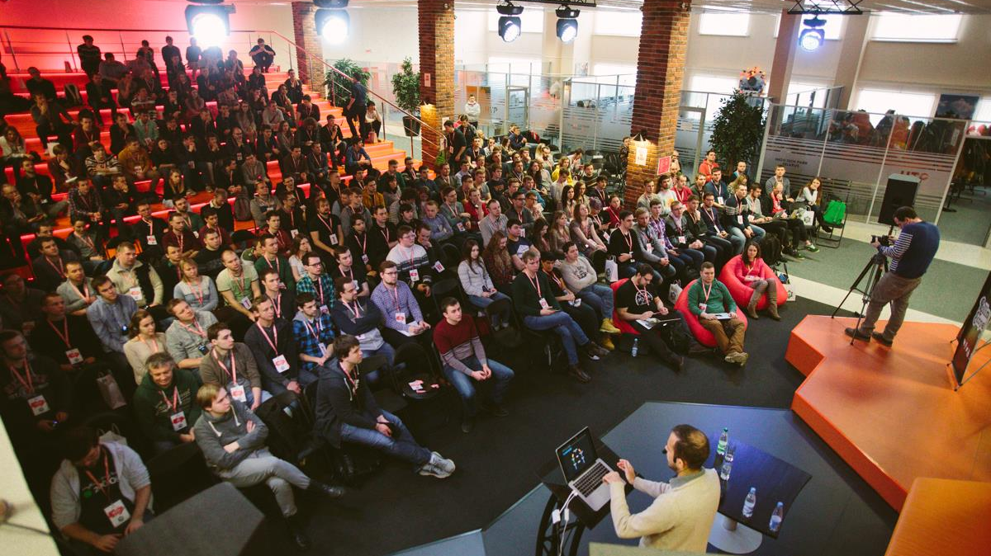
THE ROLLING SCOPES CONFERENCE 2016

Slide 12
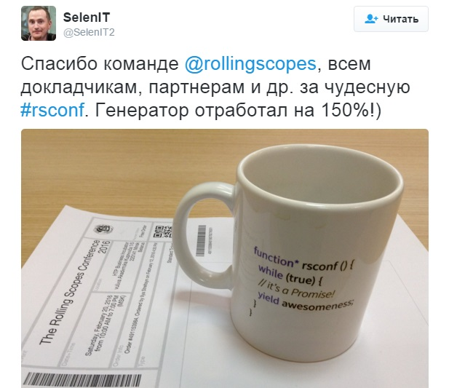
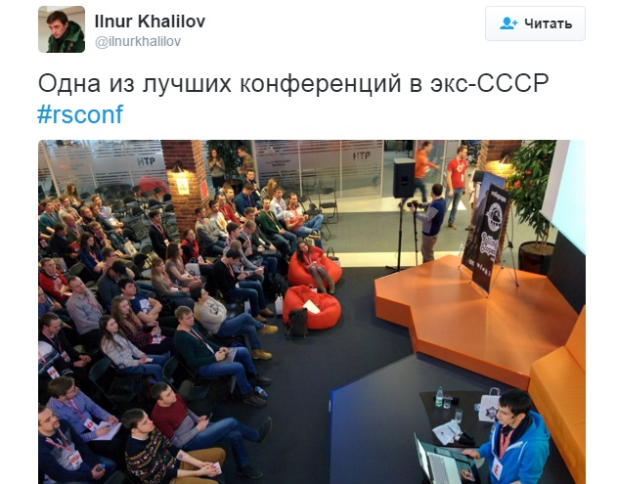
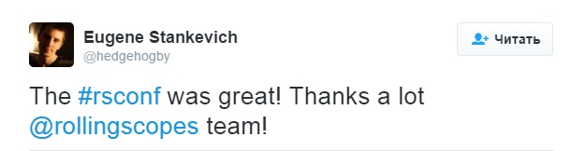
RSConf2016: Twitter Feedbacks

Slide 13
The Rolling Scopes Conference 2017
18 – 19th February 2017, Minsk

Slide 14
World Usability Day
12th November 2017, Minsk

Slide 15
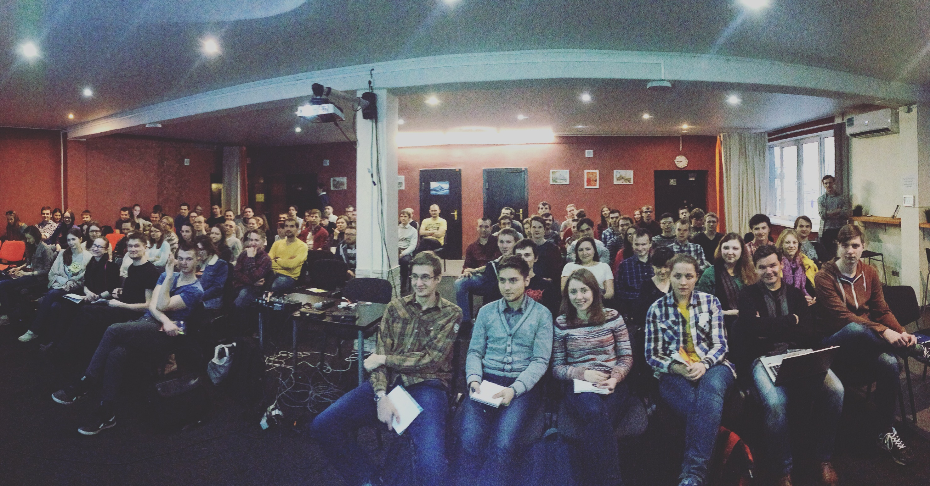
The Rolling Scopes School
120+ hours
~20 trainers
~60 attendies
6 cycles already passed

Slide 16


Slide 17



Slide 18
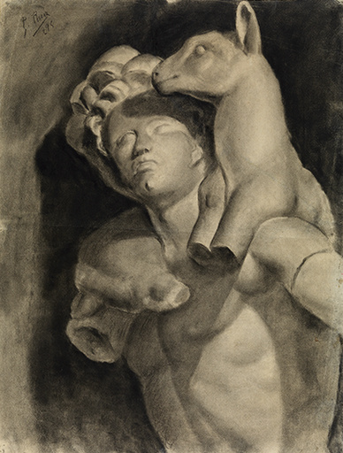

Slide 19
The Rolling Scopes School
Next loop - January 2017

Slide 20
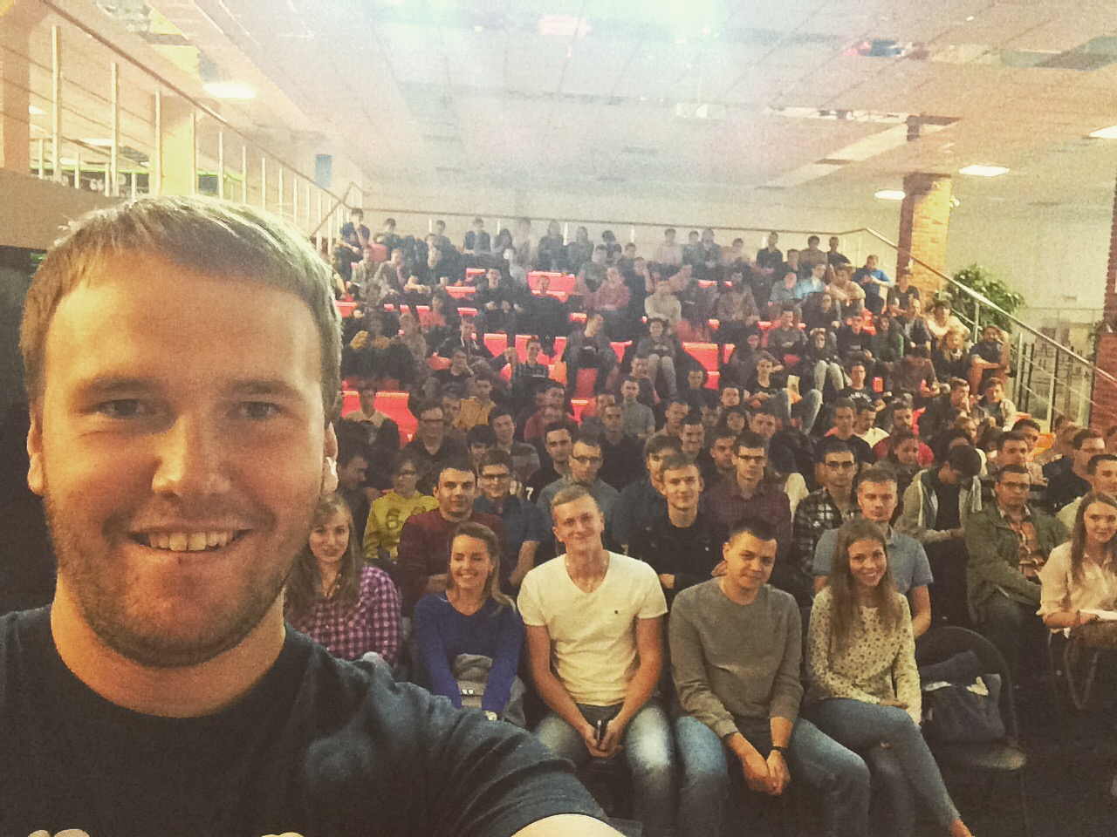
300

Slide 21
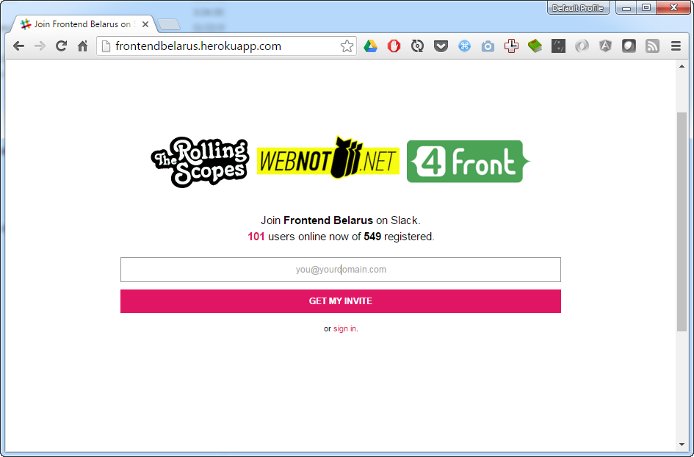
http://frontendbelarus.herokuapp.com/

Slide 22
https://rollingscopes.com/

Slide 23
Thank you!

Slide 24



Contact me
Dzmitry_Varabei@epam.com
Dzmitry_Varabei
https://www.facebook.com/dzmitry.varabei
Notes:
Text should be left aligned / icons should be broken into two columns three and three

